Slide 1
CS 414 - P3
Team We Them Boys
Alex Guentchev
Lance McMullin
Westin Musser
Jesse Schmidt
Joseph Tonski

Slide 2
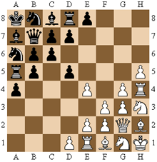
The XGAME
Legan Chess
Legan Chess
Invented by L. Legan in 1913.
Pieces start in the corners, as illustrated
Pawn movement changes
No castling, and no en passant

Slide 3
Development Process
Tools:
Azure Devops
Github
Eclipse
IntelliJ
Visual Studio Code
HeidiSQL
Practices:
2-week sprints
2 approvals required for PRs
PRs must be viewed within 48 hours

Slide 4

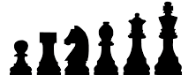
Design - Architecture
Java Spring Web Application API w/ React UI
3 Tiers
Presentation - User interface for playing the game, managing accounts, etc.
Logic - Chess engine, services for all the other moving pieces
Data Management - Communicating with the database succinctly

Slide 5
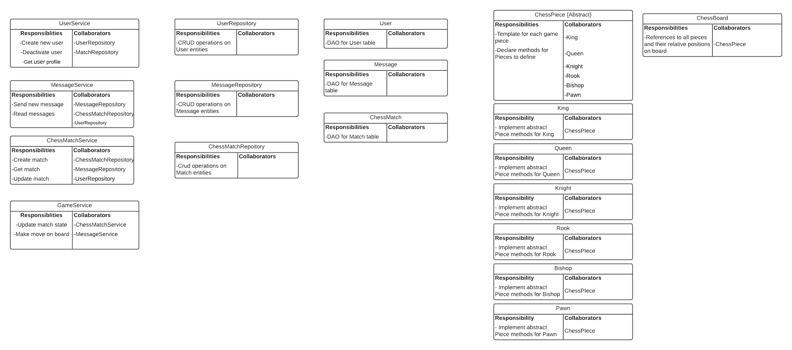
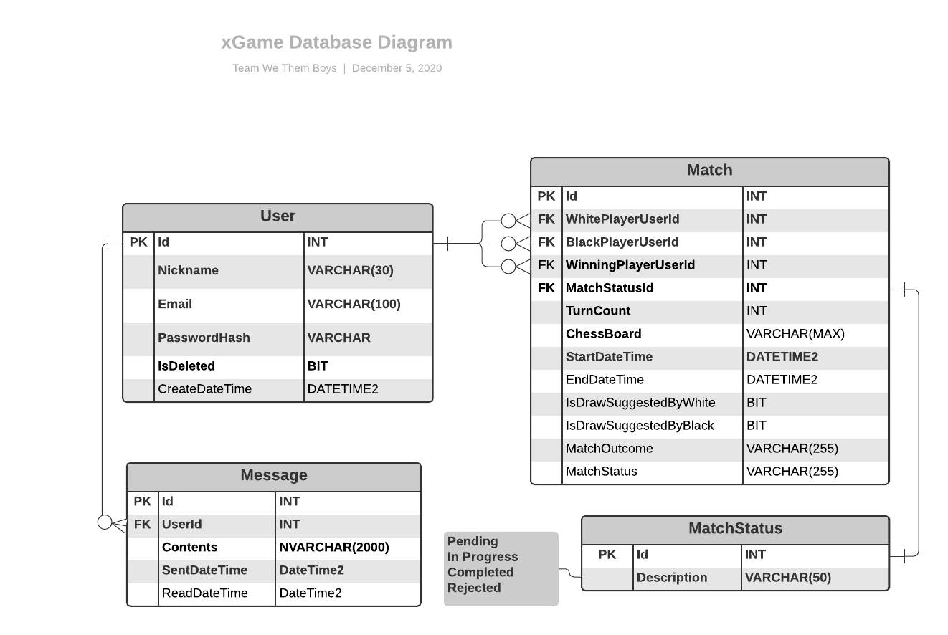
Design - Design Choices

Slide 6
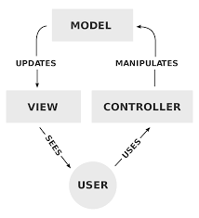
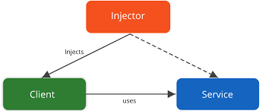
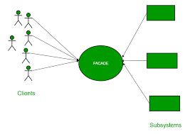
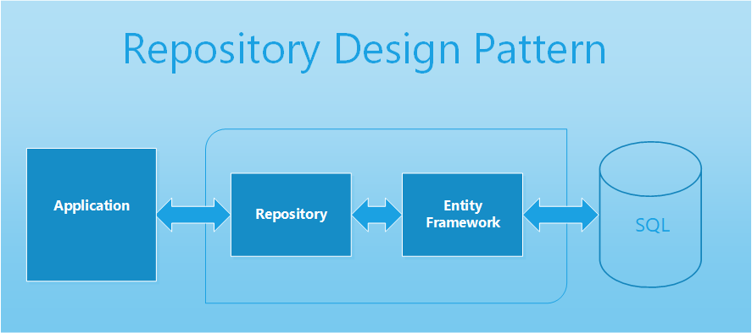
Design Patterns
Model-View-Controller
Dependency Injection
Facade
Repository

Slide 7
Lessons Learned
There is much more to do than chess logic
Manage database
Arrange UI elegantly and intuitively
Messages, registration, profiles
Tie it all together
Work in accordance with priority
Easy to get caught up in many user stories and get behind on high priority tasks
Keep front and backend in sync
Connecting the two after too much disconnect only makes it harder
Teamwork!

Slide 8
Demo!

